Slide 1
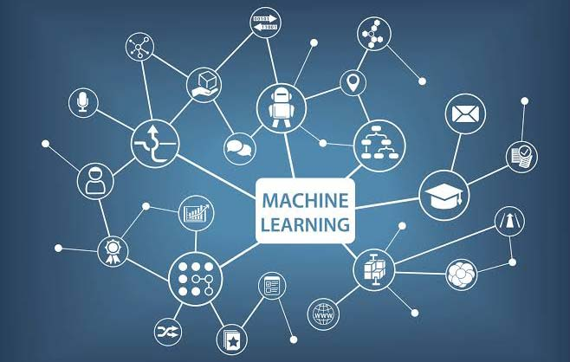

Slide 2
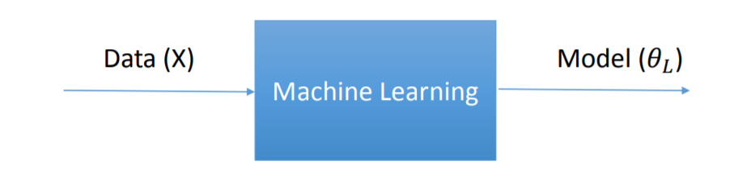
What is Machine Learning?
• Machine learning aims at developing algorithms and models for machines to perform predictions or learn to perform human tasks.
• Once the model is learned, it can be used for desired prediction of new unknown data.
ML = Representation + Evaluation + Optimization

Slide 3
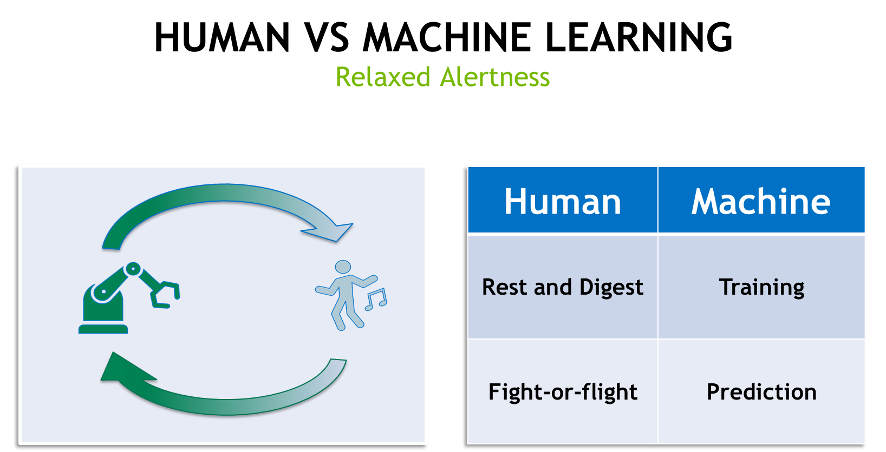

Slide 4
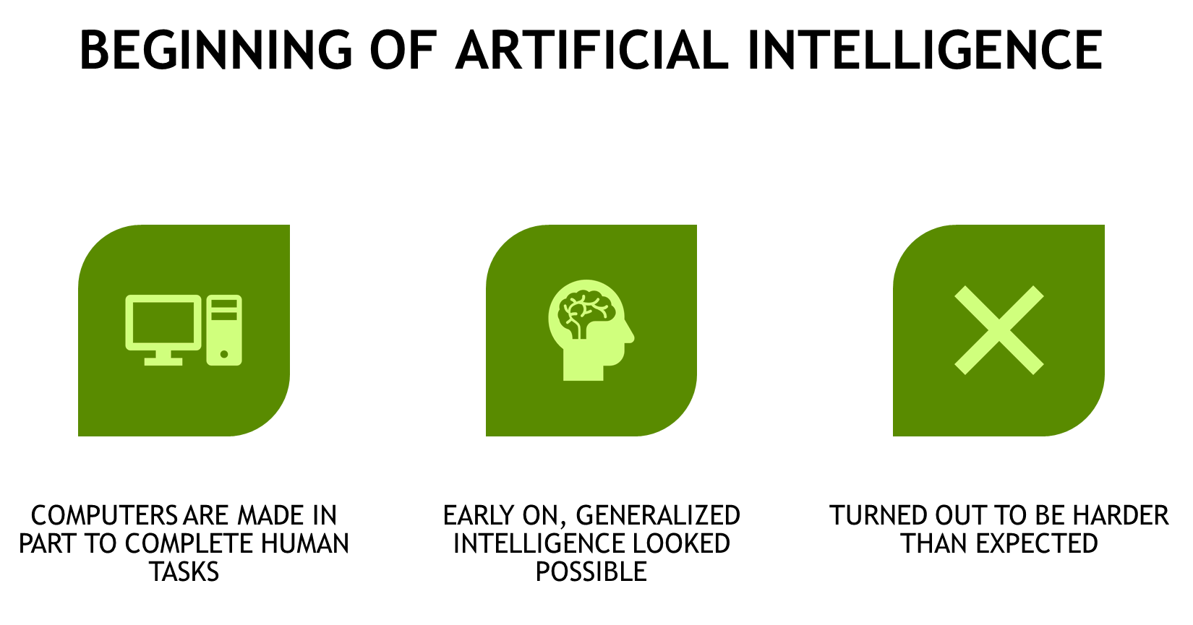

Slide 5
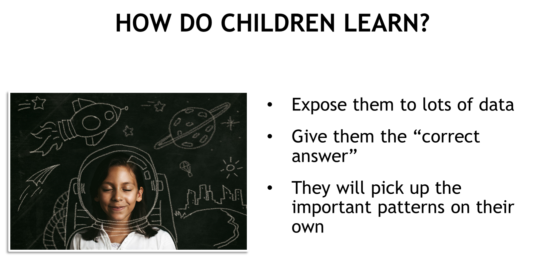

Slide 6
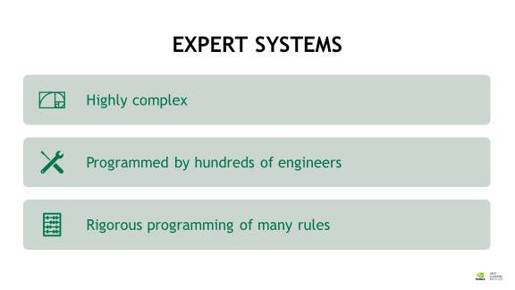

Slide 7
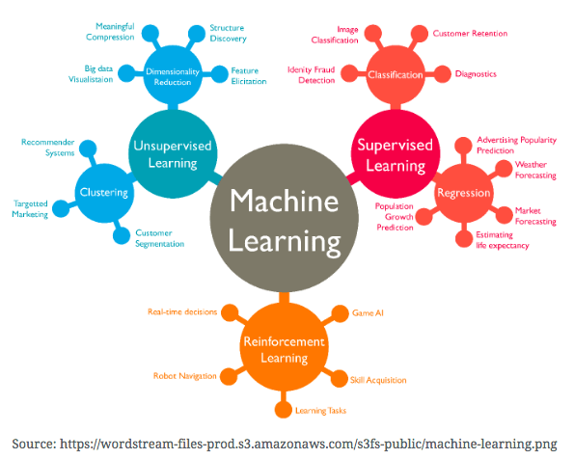

Slide 8
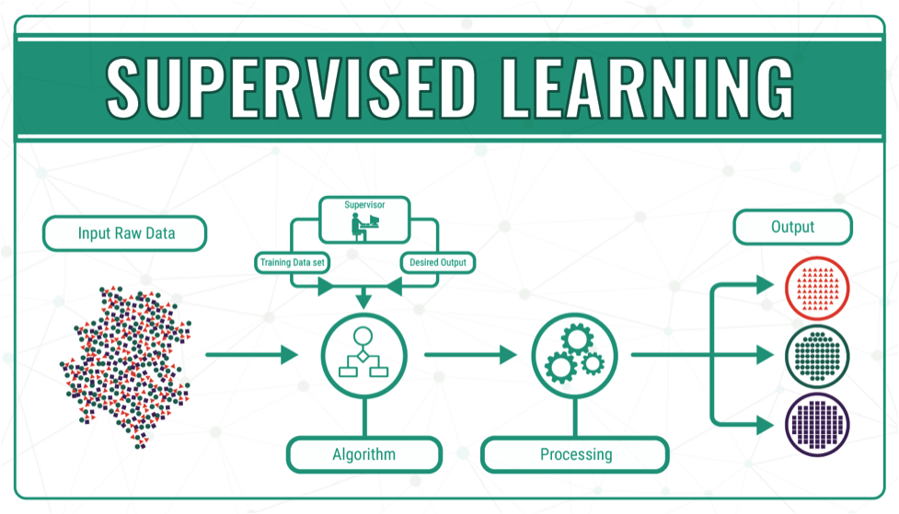

Slide 9
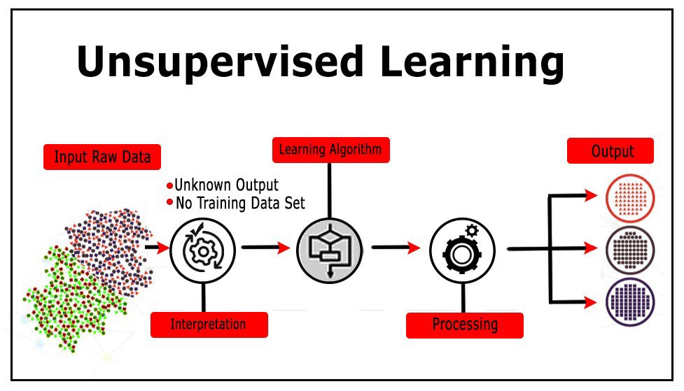

Slide 10
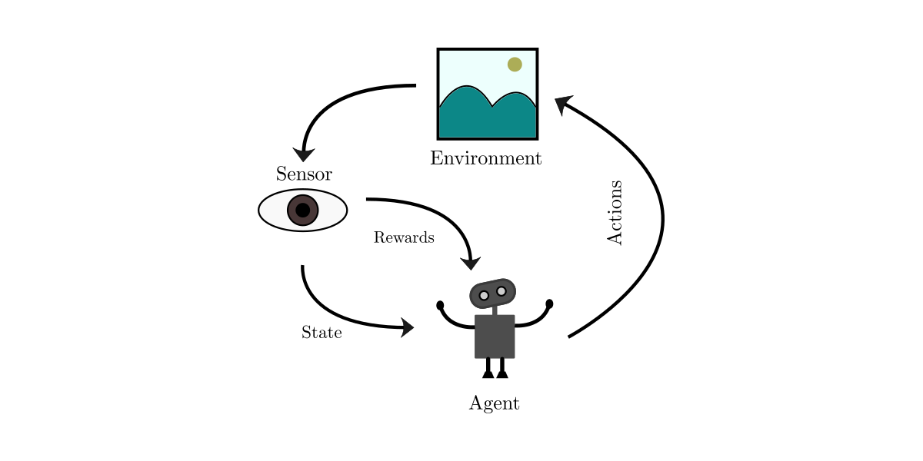
Reinforcement Learning

Slide 11
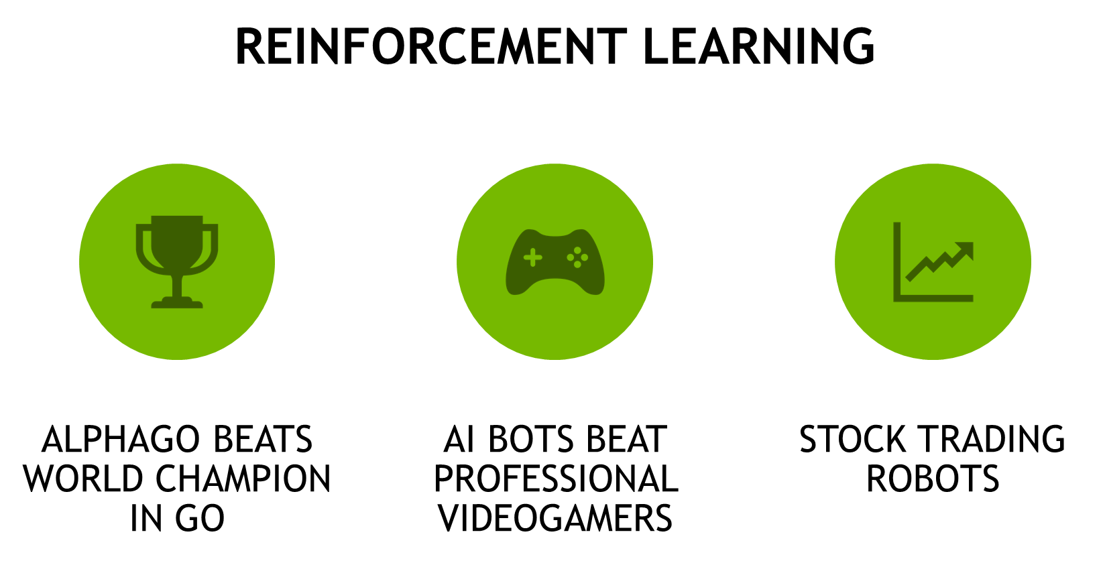

Slide 12
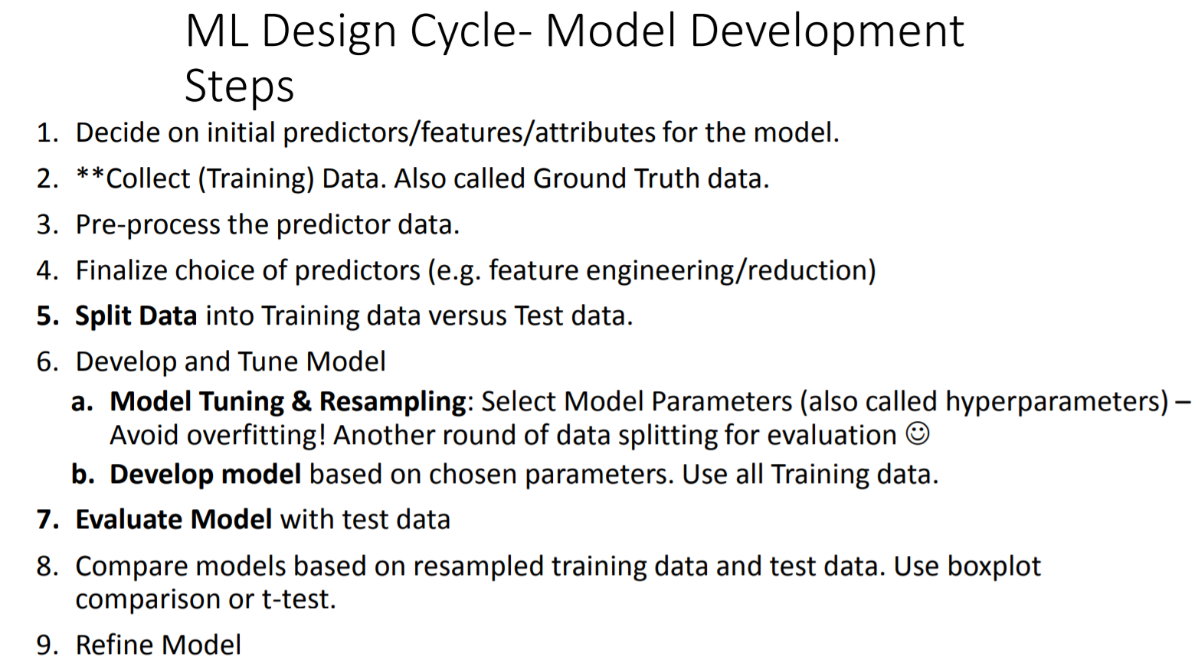

Slide 13


Slide 14
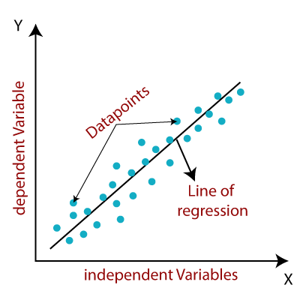
Linear Regression

Slide 15

Workshop: Predicting Credit Cards Approval

Slide 16
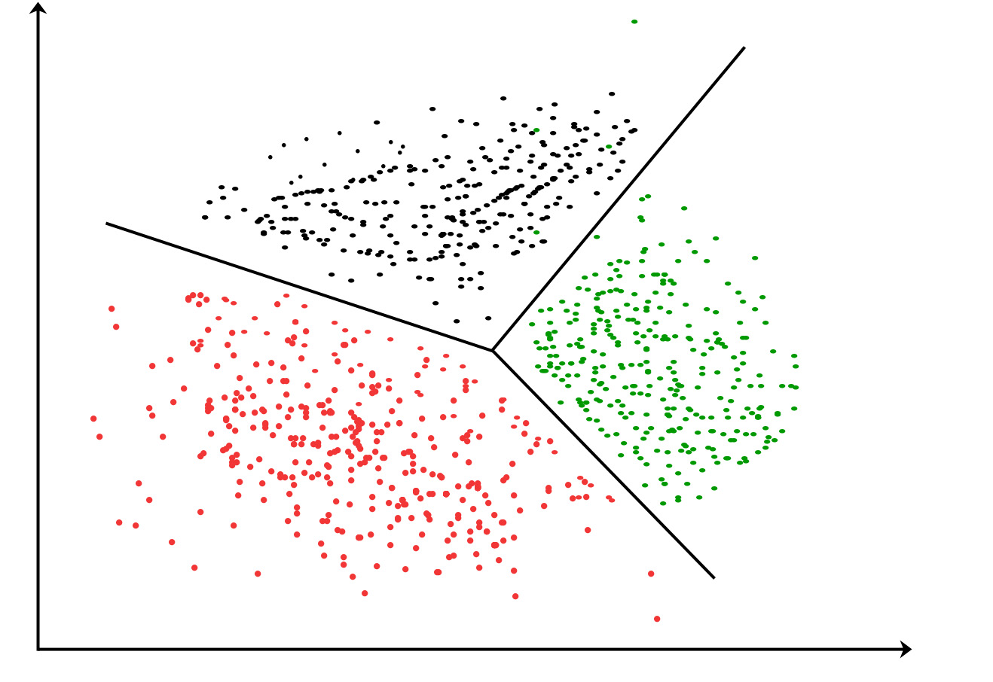
Clustering

Slide 17
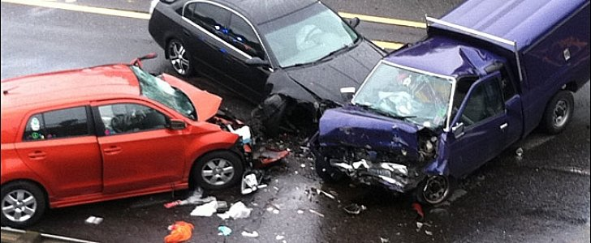
Workshop: Reducing Traffic Mortality

